Slide 1

The Manhattan’s Most Popular

Slide 2
Introduction & Business Problem
Background: The City of New York is a city of most’s:
The most populous in the United States
The financial capital of USA.
Business opportunities leader and multicultural.
The highest demand, market and vast opportunities.
Problem Description:
Manhattan was chosen as a heart of the city, meaning also a high concentration of ventures.
Popular places are not identical across the borough and each neighborhood has own rankings.

Slide 3
Data
Based on definition of our problem, factors that influenced the recommendation were:
List of Venues
Venues refer to Manhattan - a borough in New York City. Data are located at https://cocl.us/new_york_dataset and includes json file.Coordinates of Venues
Latitude, longitude will be obtained from Open Street Map APIs - an algorithm was used to determine the geodata from Nominatim.
Venues Rating
For each venue its ranking will be identified using Foursquare.

Slide 4
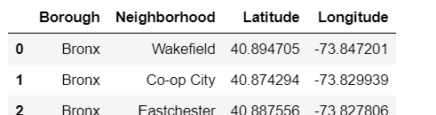
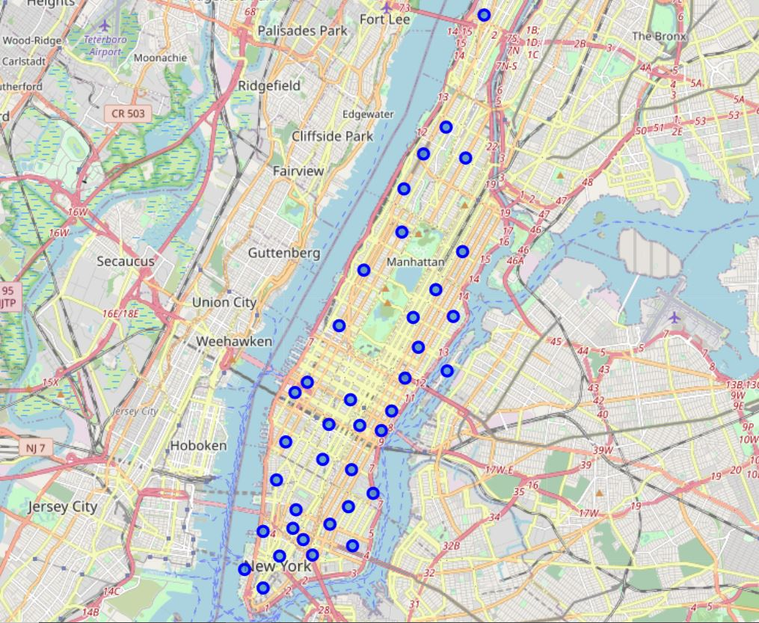
Methodology
A data on NYC boroughs, neighborhoods and coordinates was gathered and compiled to dataset.
Dataset was used in order to both get to know Neighborhoods names and its location on map.

Slide 5
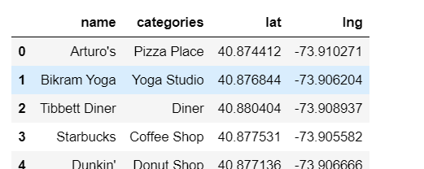
Depending on the borough, top venues were received, including their names, categories and geodata:
Each neighborhood was analyzed then in terms of categories:
Thus, a frequency of occurrence could be calculated.

Slide 6
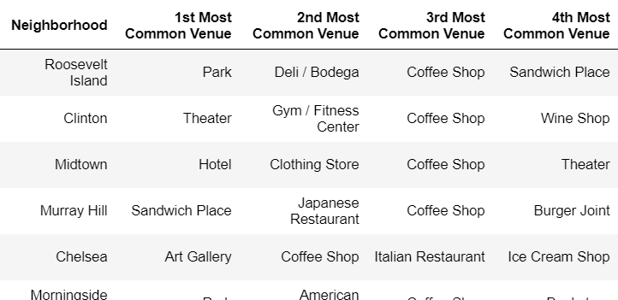
Finally, a rating for each neighborhood was obtained.

Slide 7
Results & Discussion
The most visited clusters were received. Location along Manhattan can be considered for opening a restaurants or other business depending on the idea.
Clusters map shows different markers of places in their own clusters – results presents the most popular venues in each neighbourhood which can be chosen by chief.
The analysis was done for Manhattan borough only. The same kind of analysis can be done for the entire of New York city too. This notebook can be used for similar kind of analsysis for a different city.

